Slide 1


Introduction to Python
- Part 2 -
Hilman
Raden Muhammad Hadi

Slide 2
Link Absensi
WIFI
Access Point 1:
Hadimaster
Password:
mas1234ter
Access Point 2:
Gripen6
Password:
qwerty123456
http://bit.ly/dsipythonabsensi2
Link File
http://bit.ly/dsimateripython2

Slide 3
What is Python
Why Python
Begining Python
Python 2.7 and Python 3
Interactive Shell, IDE and ICE
Let’s Code!

Slide 4
Part 1
Part 2
Basic Syntax
Data Type and Data Structure
Mathematical Operations
Logical Operations
Comparatives
String Operations
List
Tuple
Dictionary
Conditional Statement
Looping & List Comprehension
Function & Built-In Function
Input & Output
Object-Oriented Programming in Python
Array Manipulation using Numpy
Data Wrangling using Pandas
Data Visualization using Matplotlibs
Statistics using StatsModel

Slide 5
Python Is ...
High-level programming language
Open source and community driven
Dynamic typed
Run just-in-time

Slide 6


public class HelloWorld {
public static void main(String[] args) {
System.out.println("Hello, World");
}
}
Java
Python
Print(“Hello, World!”)

Slide 7
Use Python Because ...
It’s easy to learn
Jack-Of-All-Trade
A lot of module/library/package to use
Increasingly popular

Slide 8
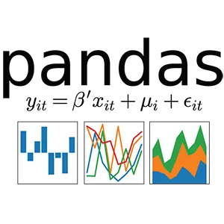
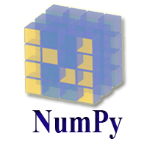

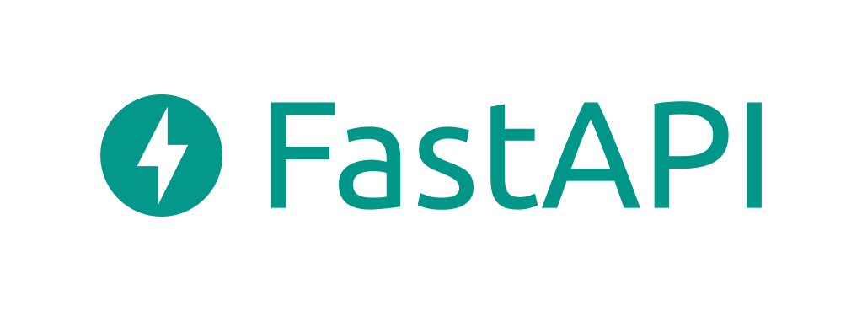



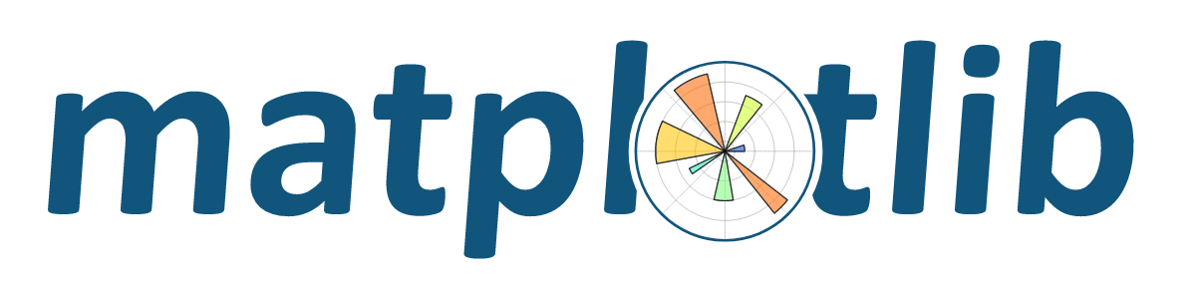






Slide 9
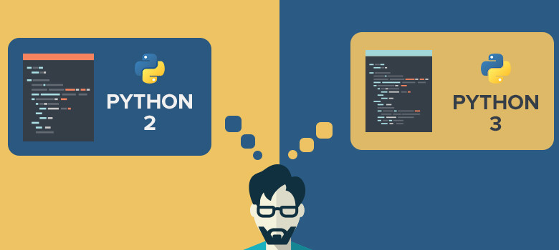
Python 2.x or Python 3.x?

Slide 10
Difference Between Python 2.x & Python 3.x
Python 2.x | Python 3.x
print “Hello, World!” | print(“Hello, Wolrd!”)
3/2 = 1 | 3/2 = 1.5
print range(3) [0,1,2] | print(range(3)) range(0, 3)

Slide 11
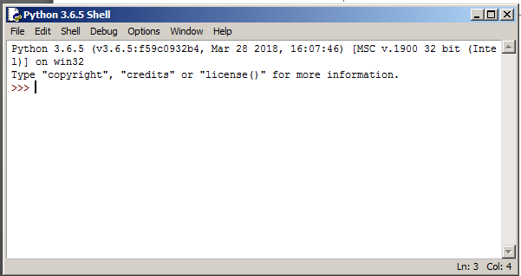
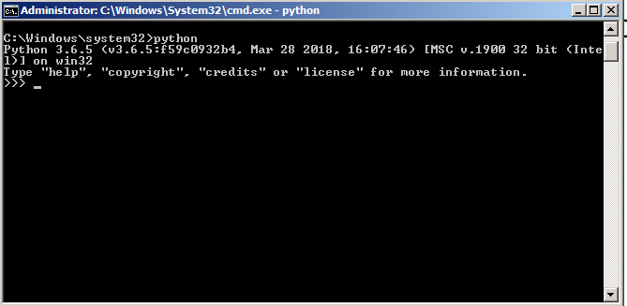
Python Shell: The Playground
Great for learning and experimenting with Python.
Lack autocomplete

Slide 12
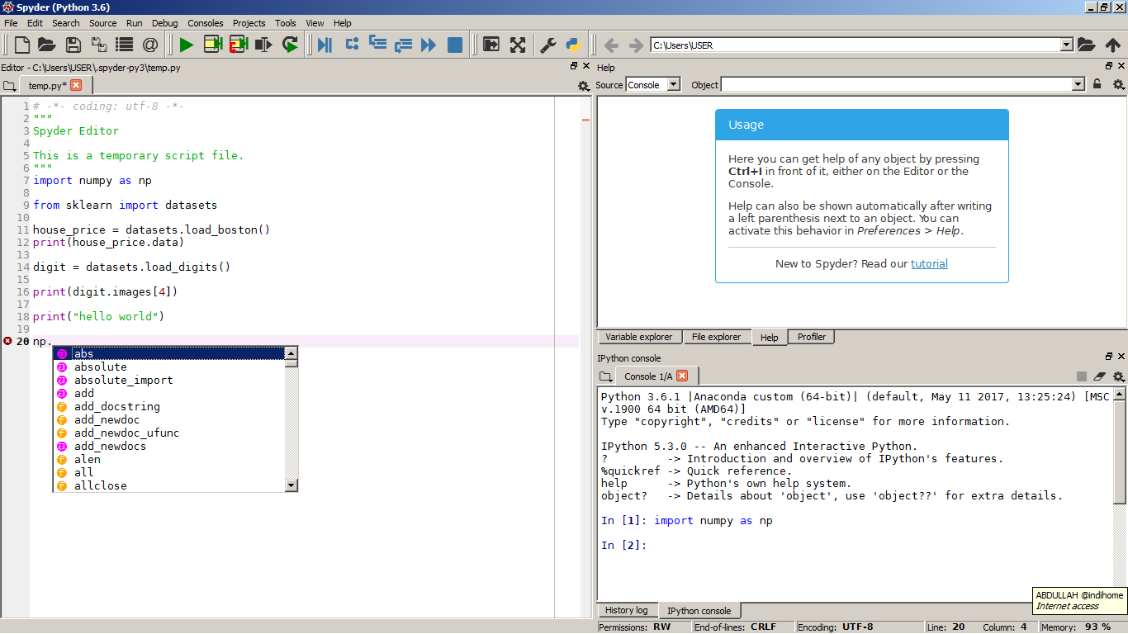
Spyder: Advanced IDE for Python
Bigger playground
+
autocomplete

Slide 13
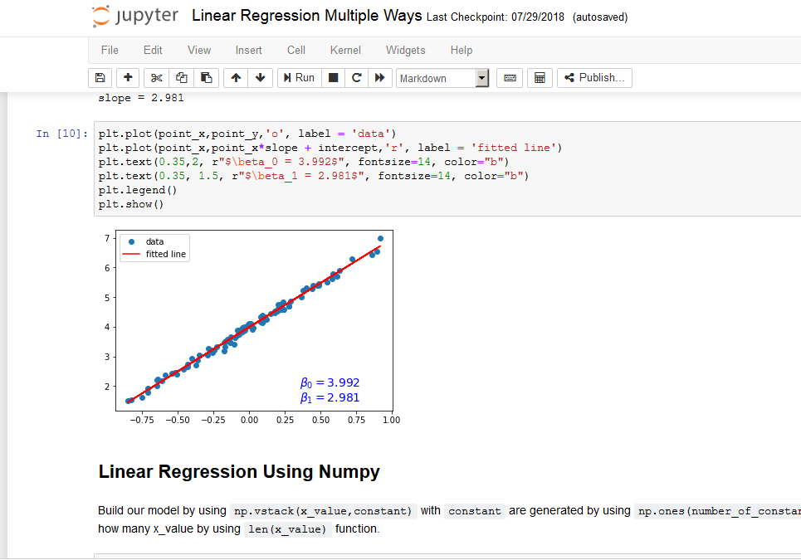
Jupyter: Interactive Computing Environment
Great for sharing research;
Build simple dashboard app;
Autocomplete

Slide 14
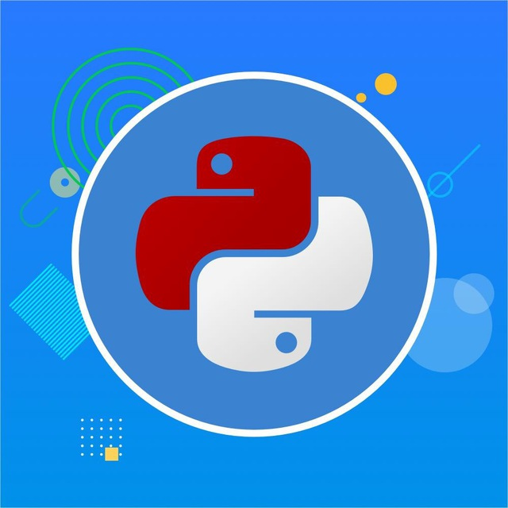
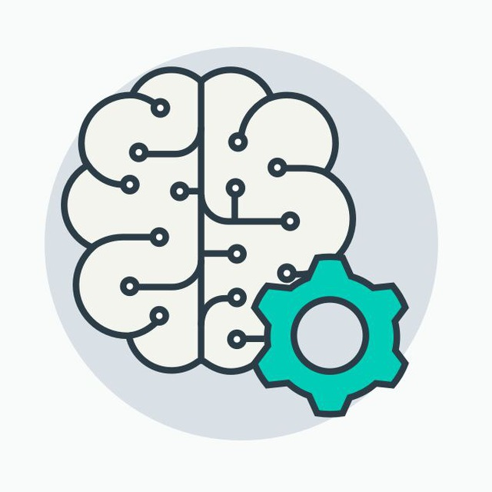
Join Python Communities!
https://t.me/pythonID
https://t.me/machinelearningid

Slide 15
Let’s Code!

